Slide 2
Nehemiah 6:15-16
15 So the wall was finished on the twenty-fifth day of Elul, in fifty-two days.
16 And it happened, when all our enemies heard of it, and all the nations around us saw these things, that they were very disheartened in their own eyes; for they perceived that this work was done by our God.
Notes:
I believe this one of the most inspirational texts found in all of Scripture!

Slide 3
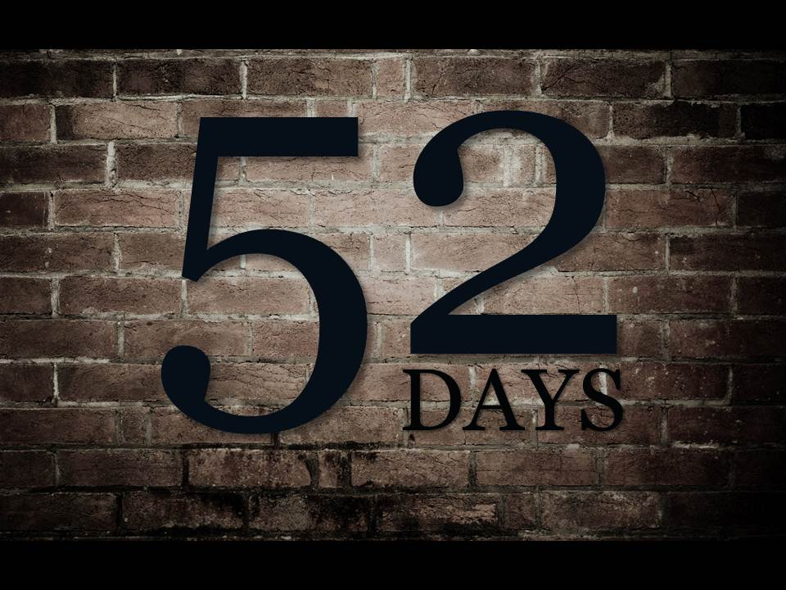
Notes:
It was absolutely incredible, monumental, what this remnant of Jewish exiles accomplished in just 52 Days! Especially when you consider the circumstances that existed and that they faced as they did this great work!

Slide 4
Fifty-Two Days
The Condition of the People of Jerusalem
  In great distress and reproach (Neh. 1:3a)
The Condition of the Walls of Jerusalem
  Broken down and the gates burned with fire (Nehemiah 1:3b; 2:13)
Their Enemies Plotted Against Them
  Nehemiah 4:1-3, 7-8

Slide 5
Fifty-Two Days
The Remnant had Strong, Godly Leadership
  Nehemiah (2:17-20); Ezra (Ezra 7:10; Neh. 8:1-8)
The People had a Mind to Work
  Nehemiah 4:6
The People Joined Together in a United Effort
  Nehemiah 3
Continued to Work & were Prepared to Fight
  Nehemiah 4:16-23
Notes:
Nehemiah Prayed and Trusted in God (1:4-11; 2:4; 4:4-5, 9; 6:9)

Slide 6
What Could YOU Do In 52 Days?
Read Through the Entire New Testament!
  I Timothy 4:13; Ephesians 3:1-6; 5:17; Col. 4:16; I Thessalonians 5:27
End a Bad Habit, Begin a Good Habit!
  Smoking, Temper, Corrupt Speech, TV, Video Games, Facebook, Internet Surfing, Etc.
  Study, Pray, Visit Sick, Family Time, Attendance
Make at Least One Spiritual Contact
  Matthew 9:36-38
Notes:
What could you accomplish in 52 Days? Sunday, July 14th – Tuesday, September 3rd (52 Days)
2) Use our time more wisely. Hospitality (open up our home to members of the church).
3) What might one spiritual contact lead to? (Araka, Brittney, Dustin, Eddie and Lezann)

Slide 7
What Could WE Do In 52 Days?
Strive for Perfect Attendance
  Hebrews 10:24-25
Every Member Increase their Giving
  2 Corinthians 8:1-5; 9:6-7
Evangelistic Effort by the Local Church
  I Thessalonians 1:8
Notes:
What could we accomplish in the Lord’s Work in 52 Days? With strong, godly leadership – members with a mind to work – brethren joined together in a united effort – just think of all the wonderful things that could happen in just 52 days!
1) Hebron Lane Church of Christ (attendance numbers was exactly the same for Sun AM, Sun PM, Wed).
2) Now to do so, you and I may very well have to cut back in other aspects of our lives (going out to eat, entertainment, grocery, etc.) Sacrifice! Every member contribute to the building fund (Ex. 36:3-7). How soon could we achieve our financial goal if we all dug deep?
3) Evangelistic Effort by Local Church – instead of one or two, the church as a whole involved in such efforts. What could potentially happen? Special classes on personal evangelism. Also, during the next 52 Days our gospel meeting with Jarrod Jacobs will occur. What could the congregation accomplish together for that special week?

Slide 8
What Things Will Prevent Us?
Spiritual Laziness
  Nehemiah 3:5b; Matthew 25:25-27
Lack of Interest and Zeal
  Revelation 3:15-16, 19
Busy with the Cares of This Life
  Mark 4:18-19; Luke 14:16-20
Possessing a Spirit of Fear
  Proverbs 29:25; 2 Timothy 1:7-8
Notes:
1) If we are allergic to “church work” then nothing will be accomplished in this local work.
3) Distracted with the pursuits of this world. Fill our time with things that pertain to the physical life, rather than the spiritual.

Slide 9
What Things Will Help Us?
Strong, Godly Leadership
  Nehemiah 4:16; Romans 12:8; I Peter 5:2-3
Planning and Goals
  Proverbs 20:18; 21:5a; Philippians 3:14
Fervent Prayers
  Nehemiah 1:4-11; 2:4; 4:4-5, 9; 6:9
  Colossians 4:2; James 5:16; I Thess. 5:17
Notes:
Zig Ziglar – “If you aim at nothing, you will hit it every time.”

Slide 10
What Things Will Help Us?
Everyone Participating
  Nehemiah 3:1-4; 4:6; Ephesians 4:15-16
Zealous Members
  Neh. 2:18; Romans 12:11; 2 Corinthians 9:2
Perseverance and Endurance
  Hebrews 6:11-12; 10:36
Notes:
After Nehemiah had surveyed the broken down walls of the city, he said to the Jews: “Come and let us build the wall of Jerusalem, that we may no longer be a reproach.” They responded by saying: “Let us rise up and build.” Then they set their hands to this good work (Neh. 2:17-18). Brethren let’s set our hands to these good works. Let’s get involved, each and everyone of us, in the work that goes on here.

Slide 11
Notes:
The 52 Day Challenge? Are you up for it? Are you in?

